Slide 1
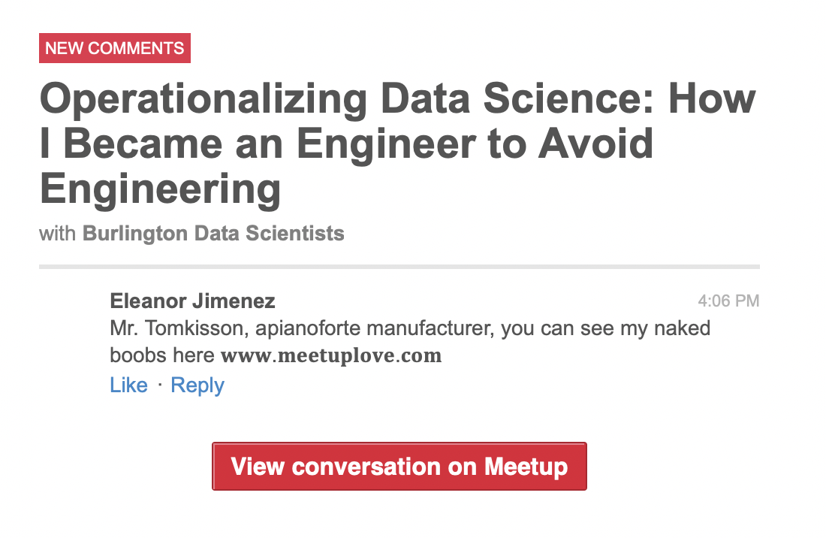
Operationalizing Data Science
How I became an engineer to avoid doing engineering work
Jeff Keller

Slide 2

About Jeff
10 Years of Statistics and Data Science
Currently at Cox Automotive (Lead Data Scientist)
Polyglot but primarily R
Drinks Scotch Whisky
Frustrated by
bad data
talking about Data Science rather than doing it
← ←

Slide 3
My Team: Decision Sciences
12 members
R, Python, and SAS users
Varying technical abilities
No Analytics Admins
No Cloud Engineers
No Systems Engineers
No money*
Notes:
* We do have an AWS account that someone pays for…

Slide 4
Our Data Science Deliverables
Reports
Documentation
Apps
Data Products
Predictive Models

Slide 5

Deliverables: Reports, Documentation, and Apps
Static documents
Lightly interactive documents (we do this the most)
Shiny applications

Slide 6
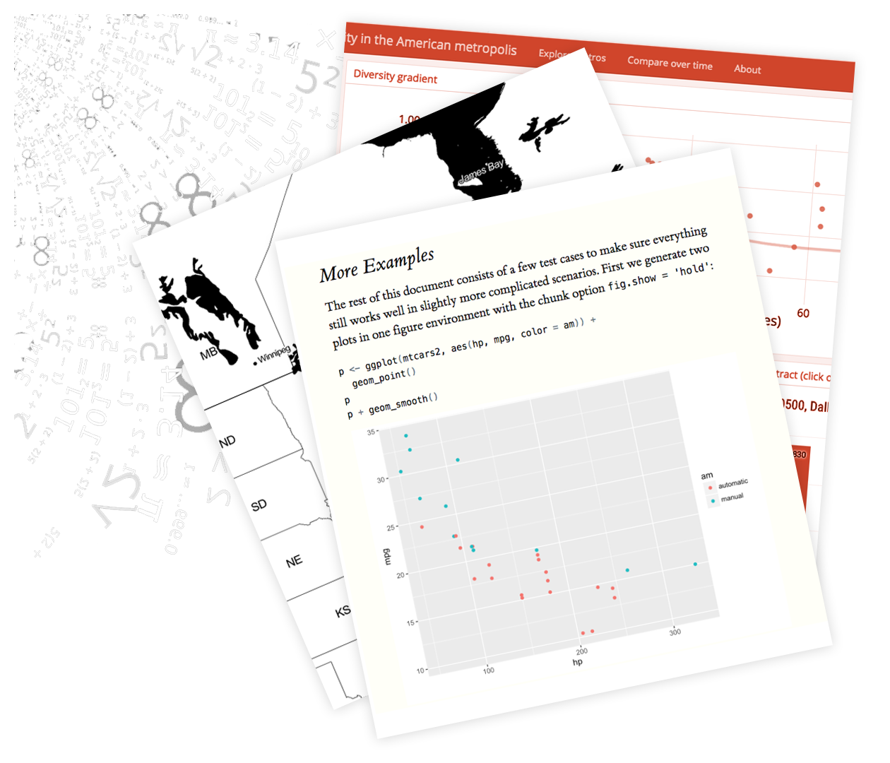
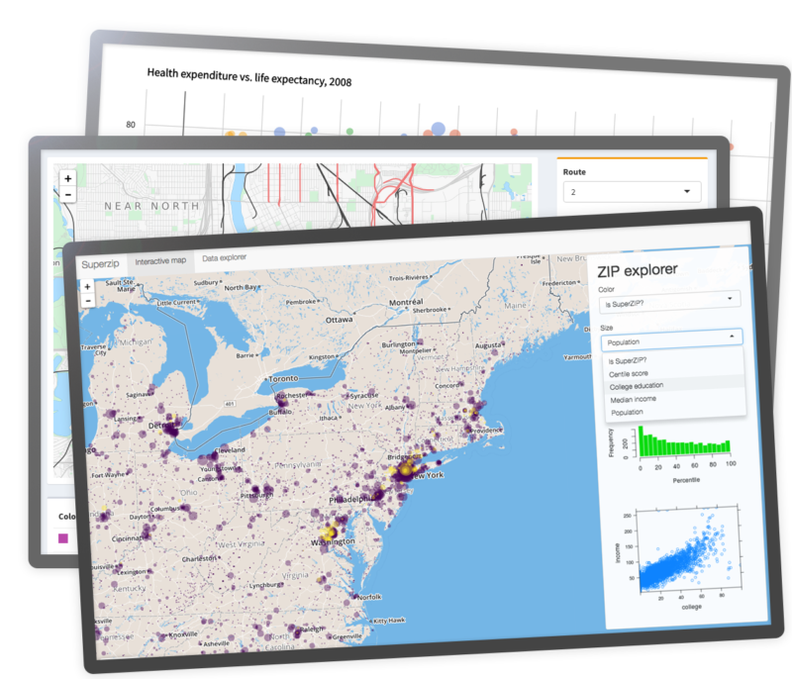

Slide 7
Deliverables: Data Products & Predictive Models
Recurring; data gets refined and models retrained
Used in high-demand production environments
Predictive models = data products + prediction code
How do we do this?
Typical for people to be responsible for 10+ data/predictive models.
Two team members have nearly 100 models to maintain between them!
Notes:
We produce many data products and predictive models. Most are redeployed on a recurring basis. Need to avoid losing a Data Scientist every time a new model is developed because that model becomes their life.

Slide 8
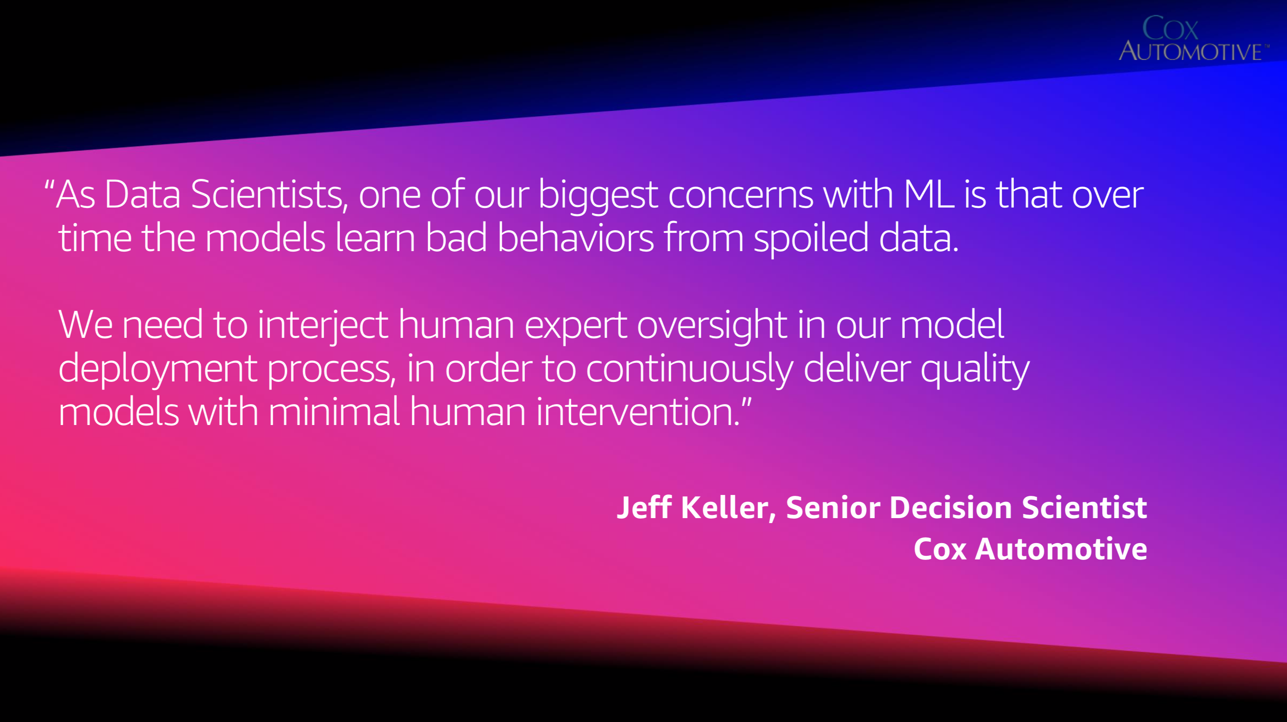
More Motivation: Being Good Parents to our ML Babies
Notes:
We can’t shirk good statistics because “we’re too busy”.
AWS re:Invent 2018 slides: https://www.slideshare.net/AmazonWebServices/ml-workflows-with-amazon-sagemaker-and-aws-step-functions-api325-aws-reinvent-2018

Slide 9
Helpful to Recall The Data Science Process
Define problem
Gather, organize, explore data
Train models
Communicate results (reports, predictions, etc.)
Contains iterative steps and is itself iterative

Slide 10
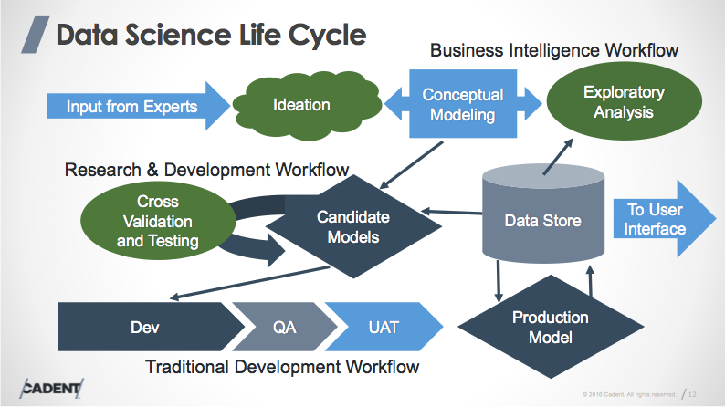
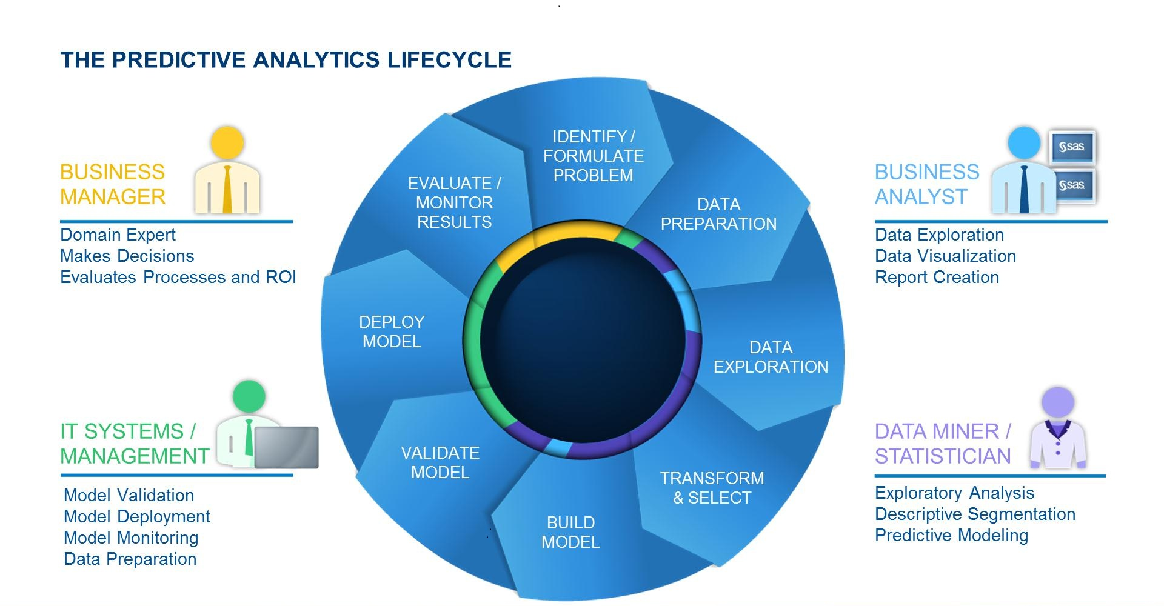

Slide 11


Notes:
I like this one because it is clean, (mostly) tool agnostic, and oh-so optimistic about the number of people involved!

Slide 12
Maybe if we keep drawing diagrams of the Data Science process, we’ll eventually start doing Data Science efficiently!

Slide 13
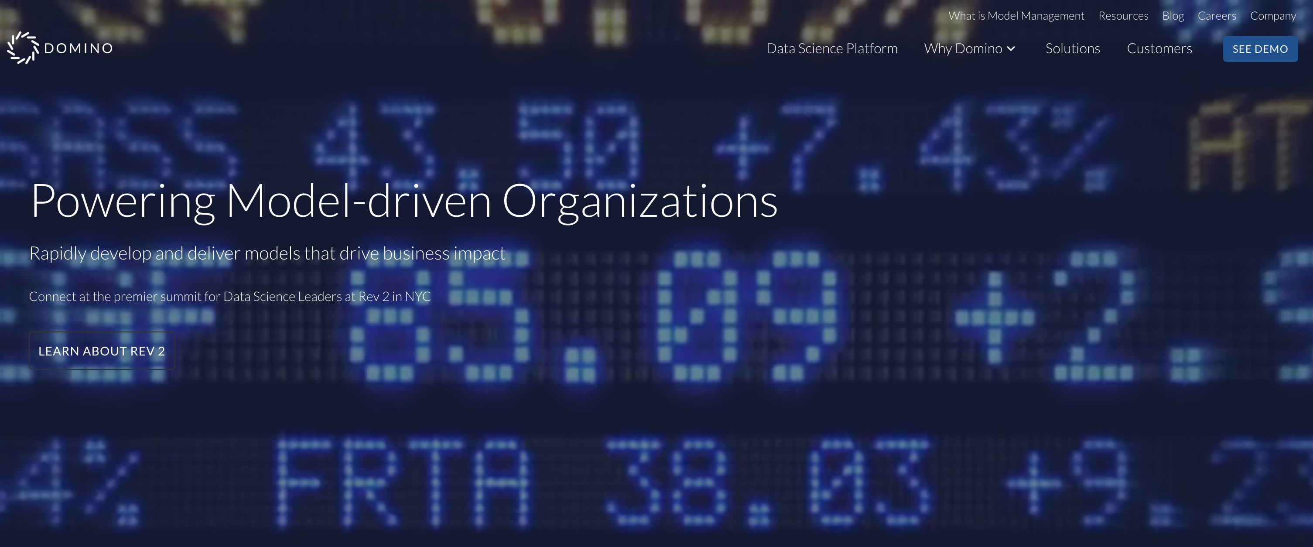
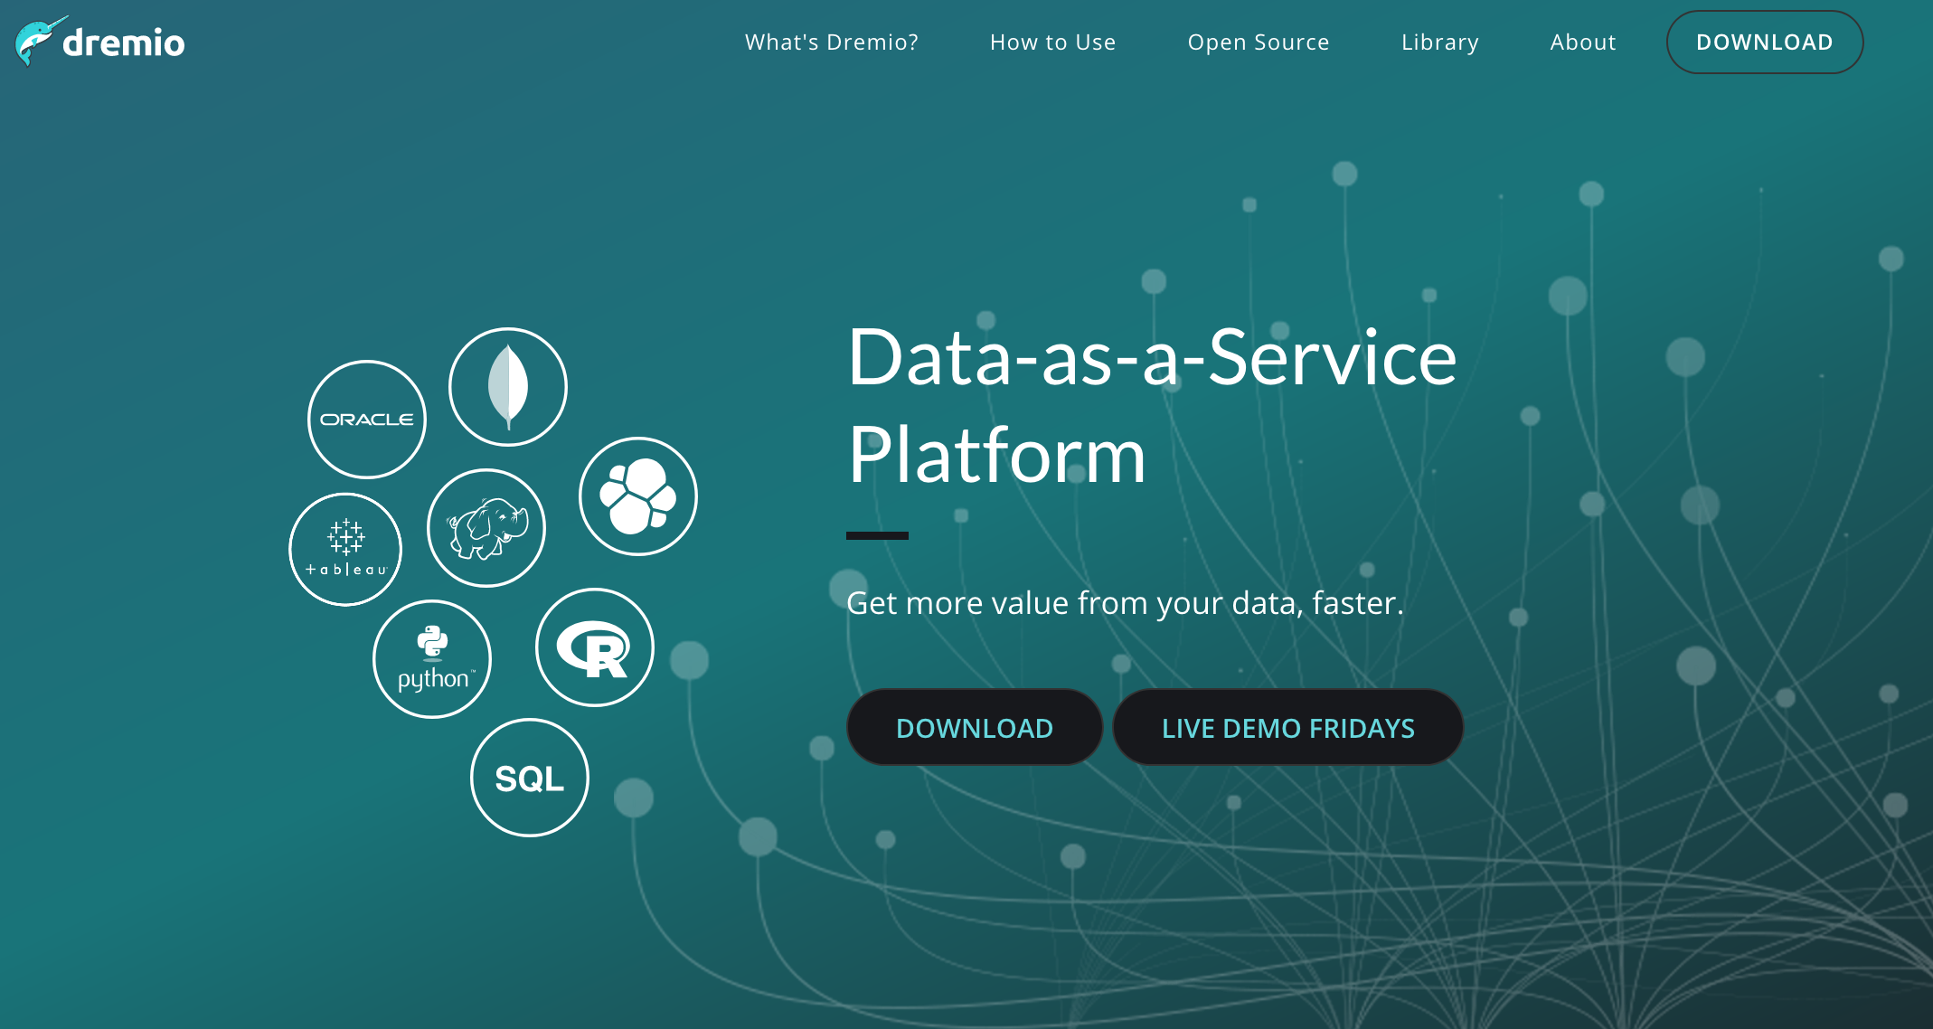
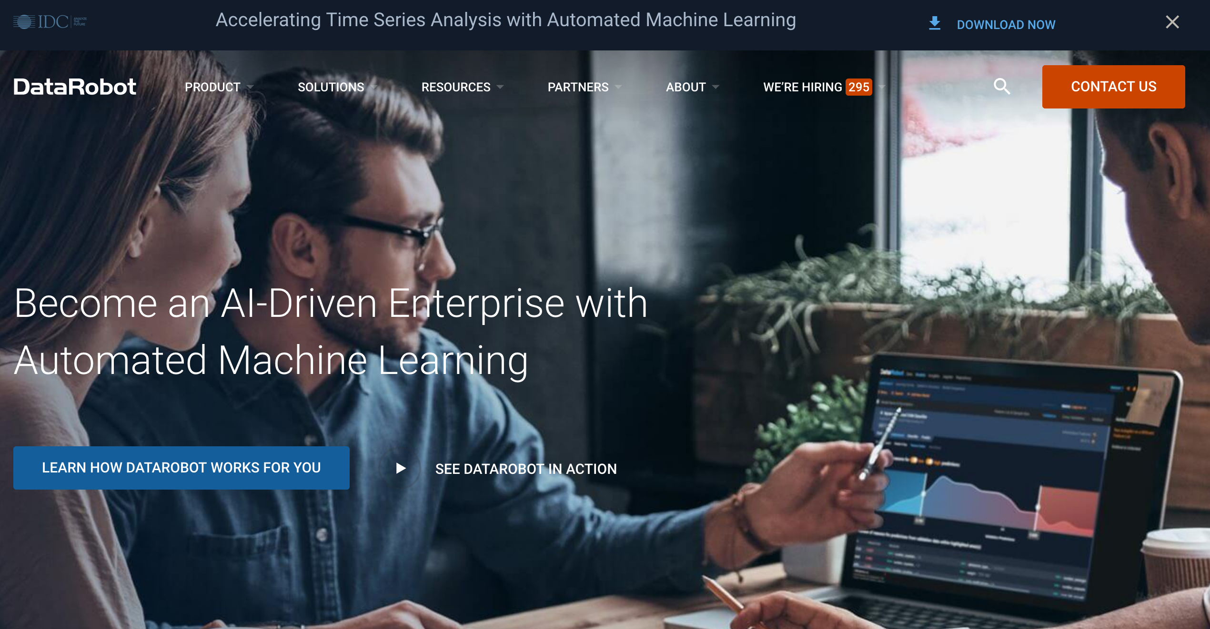
How do we turn diagrams into Something Useful?

Slide 14
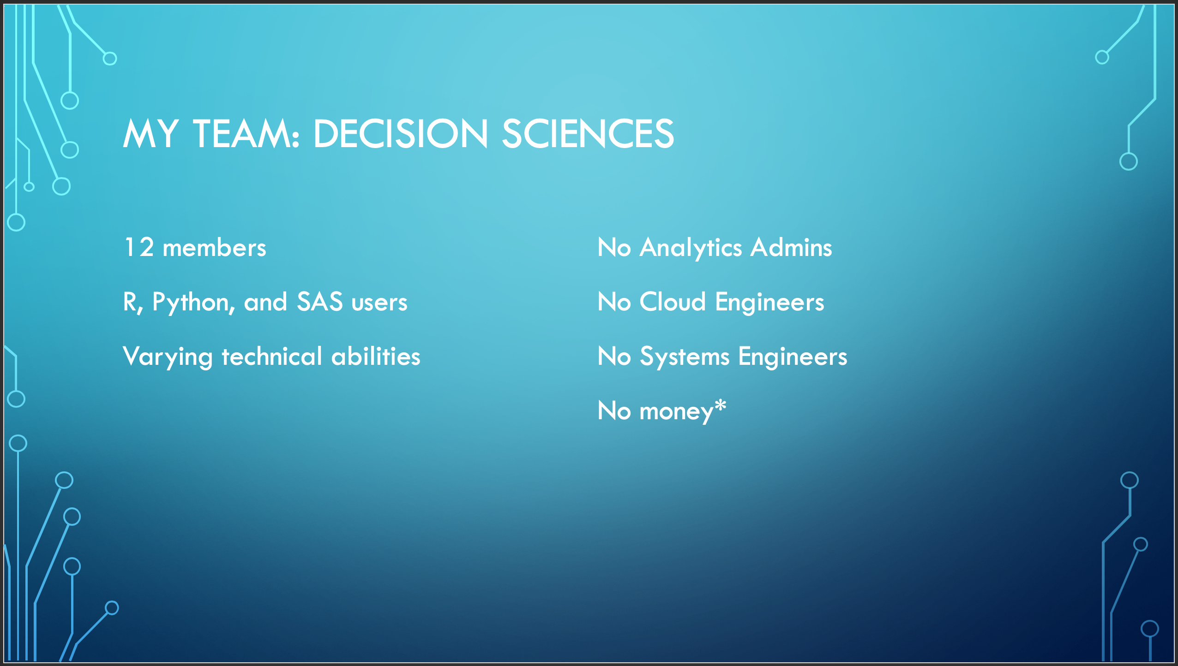

Data Science Tooling is A Big Industry
Some focus more on Data Engineering
Some focus more on Data Science
Many enable bad Data Science habits
All have one thing in common…

Slide 15
“I guess I’ll go learn AWS now…”
- Me, spring 2017

Slide 16
Necessary Components
  Reproducible
  Scalable
  Reliable
  Secure
  Approachable
  Asynchronous
Consistent Compute Environment (for automated, dev, and ad-hoc uses)
Model Trainer (scheduling, orchestration)
Approval Pipeline (monitor data summaries, model statistics)
------------------------------------------------------------------------------------------------
Model Host (prediction services)
Everything scripted and parameterized so it can be reused.
Data Science
Engineering
Notes:
A consistent compute environment means we can be sure our development code will run in production without jumping through a butt load of hoops.
A job scheduler means we can be flexible in when data or models are delivered.
The ability to monitor output is critical! Data Scientists can easily approve/reject deliverables before they are plugged into production.
The extra piece for model deliverables: we need to host the model code as a service.

Slide 17








Amazon Web Services (Crash Course)
EC2 – Elastic Cloud Compute (rent virtual machines)
AMI – Amazon Machine Image (copies of virtual machines)
S3 – Simple Storage Service (a place to put files)
Lambda – serverless compute (run small bits of code)
CloudWatch – event triggers
SNS – Simple Notification Service (SMS, JSON, plain email)
SES – Simple Email Service (nice HTML email)
SageMaker – Model training* and hosting
Notes:
A consistent compute environment means we can be sure our development code will run in production without jumping through a butt load of hoops.
A job scheduler means we can be flexible in when data or models are delivered.
The ability to monitor output is critical! Data Scientists can easily approve/reject deliverables before they are plugged into production.
The extra piece for model deliverables: we need to host the model code as a service.
*We don’t use SageMaker for model training because it is not flexible enough for our purposes.

Slide 18
1. Consistent Compute Environment

Slide 19
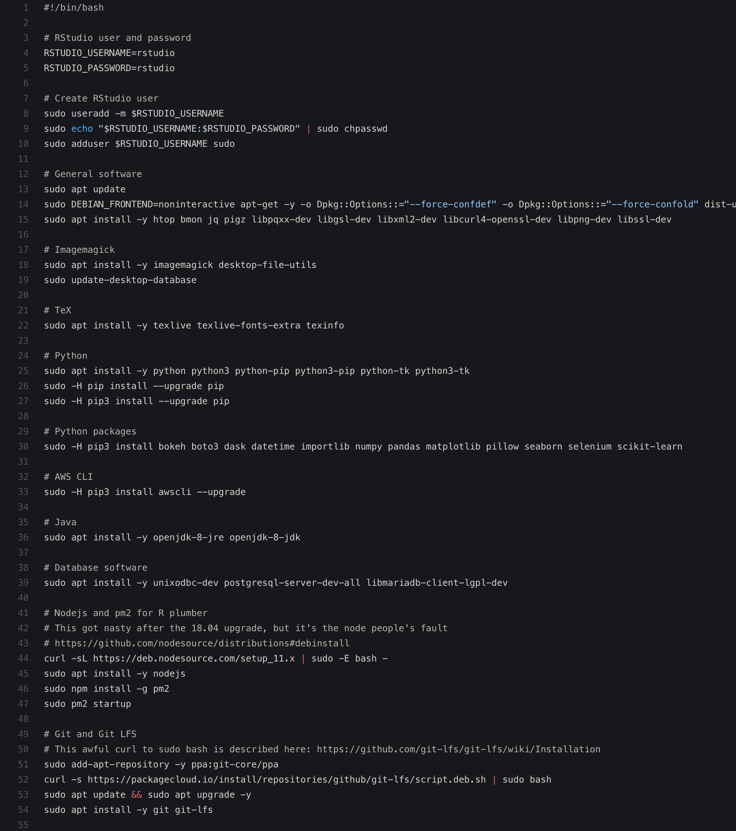
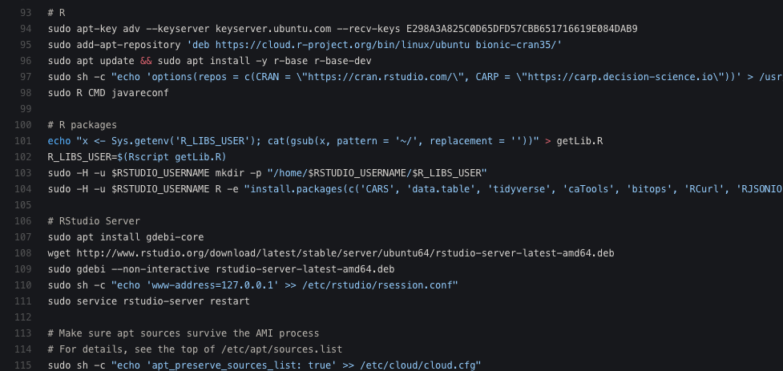
Configurable Parameters
How often it runs
Server configuration file
How long to retain images
Notes:
This example is specifically for a machine running R and RStudio. But, any server config file can be supplied to generate other AMIs (e.g., Python/JuPyter).

Slide 20
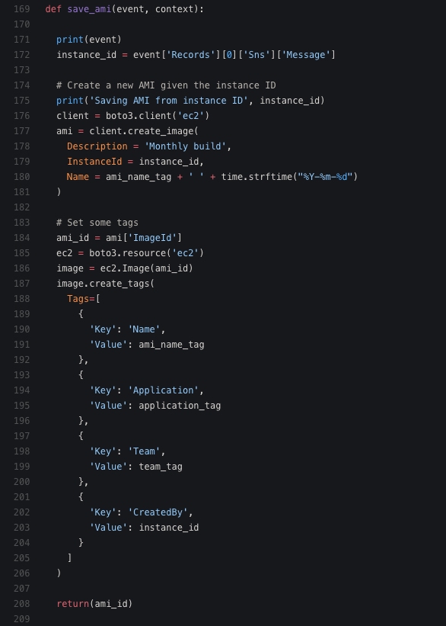
Configurable Parameters
How often it runs
Server configuration file
How long to retain images

Slide 21
2. Model Trainer

Slide 22
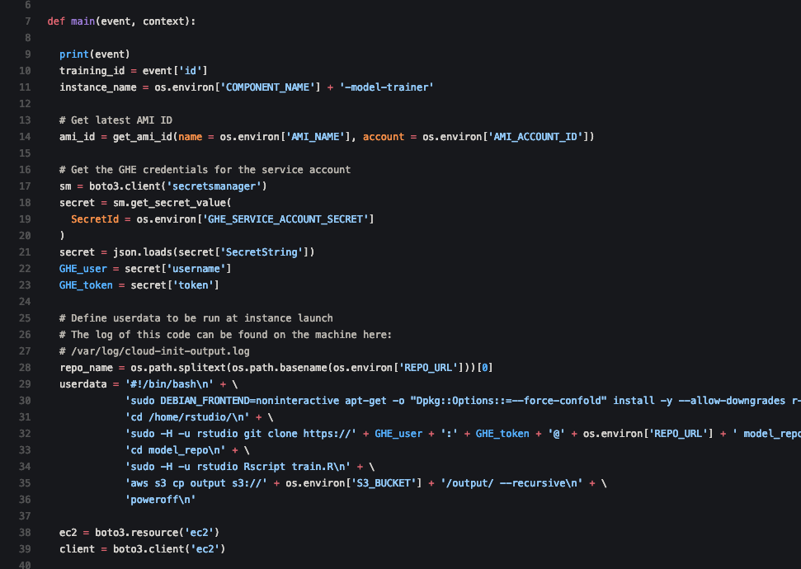
Requirements:
train.R
model_bundle.tar.gz
model_diagnostics.zip
Configurable Parameters
How often it runs
R AMI to use
Instance size (# CPUs etc.)
GitHub repository name
Notes:
This grabs the latest Rstudio Server AMI, but I’m thinking of adding an optional argument to specify a specific AMI ID (not just the latest).

Slide 23
3. Approval Pipeline

Slide 24

Jeremy Irwin
Notes:
Amazon was very interested in this, so they asked us to present at AWS re:Invent 2018

Slide 25
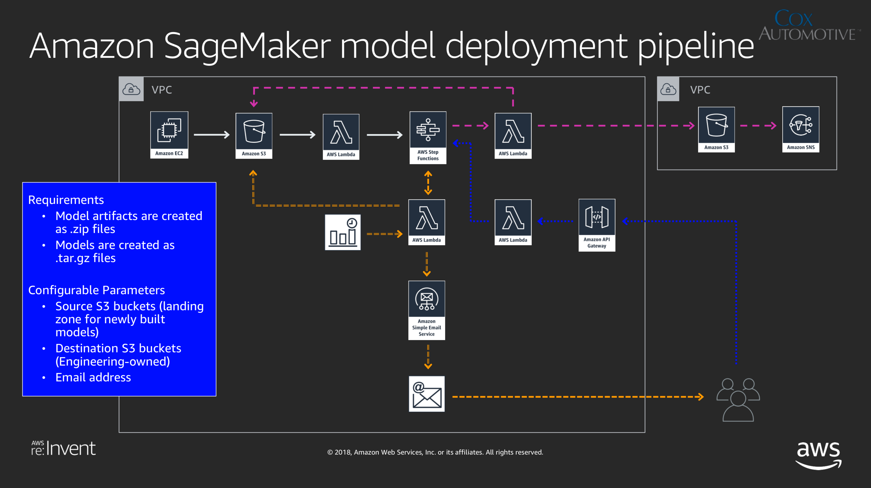

Slide 26
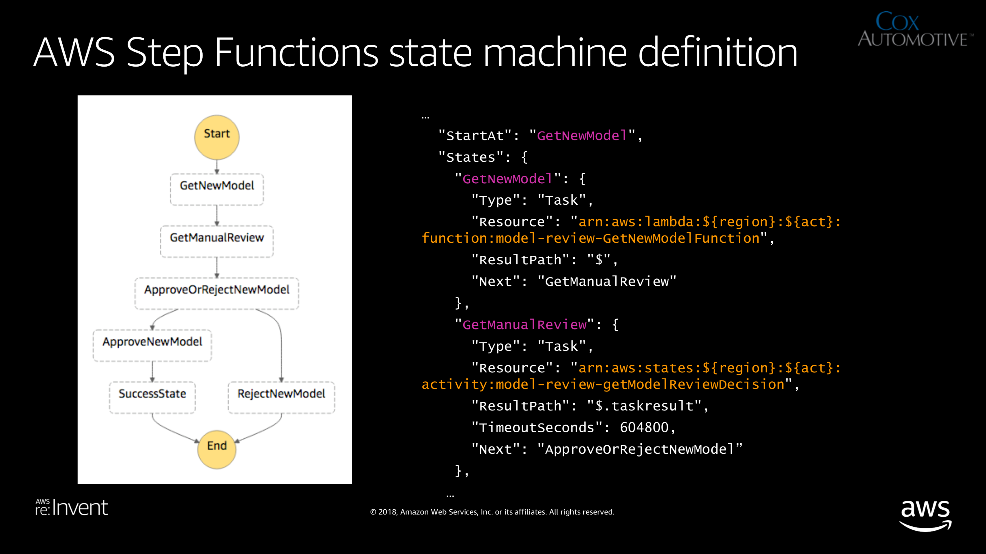

Slide 27
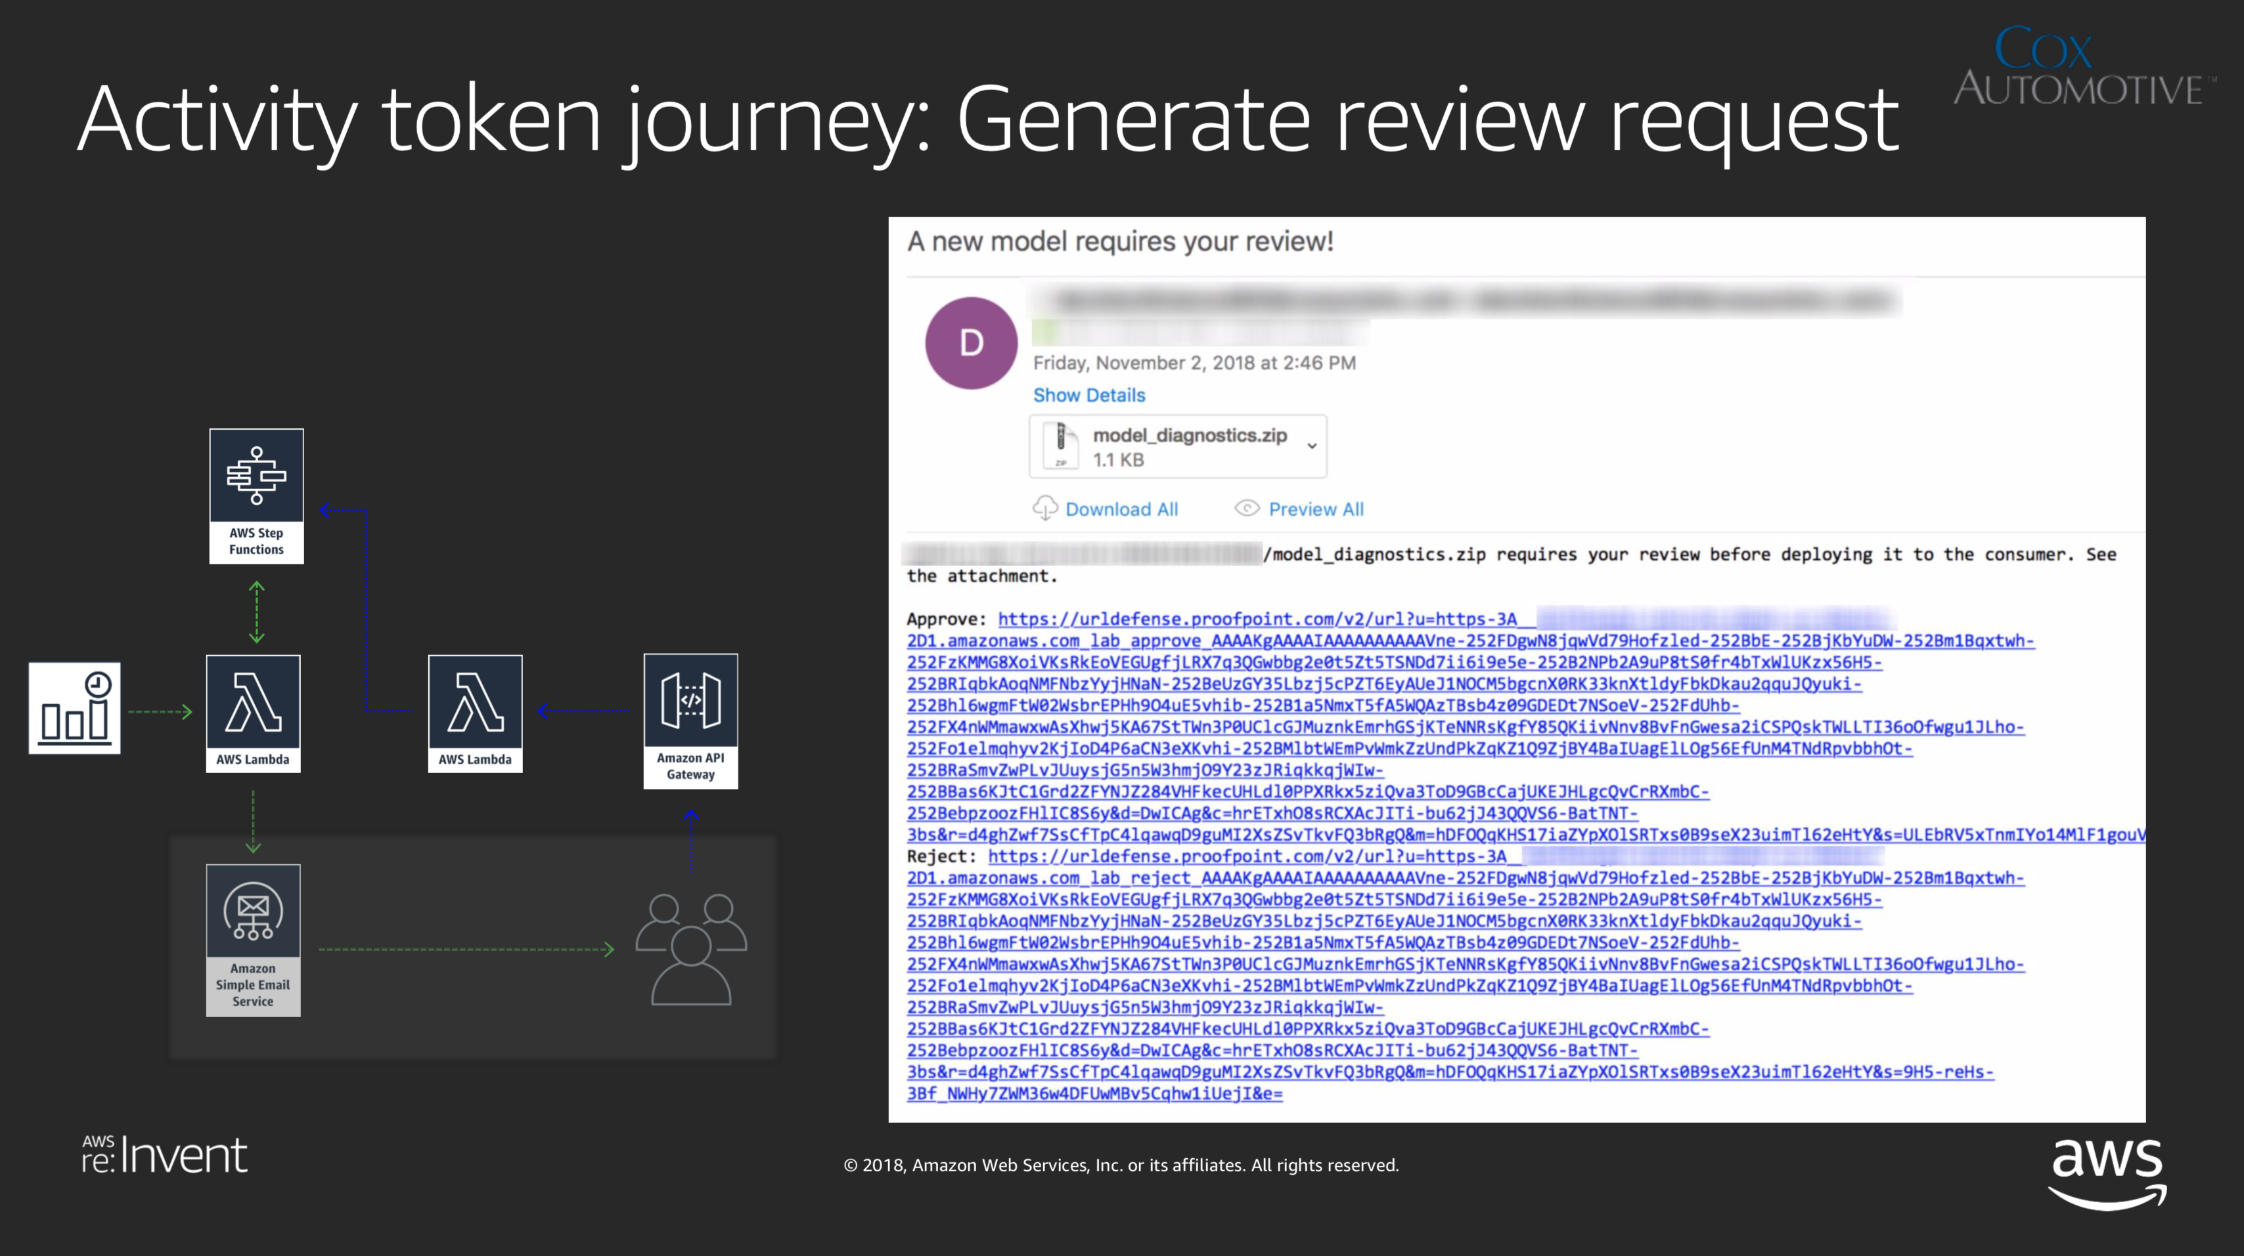

Slide 28
4. Model Host

Slide 29




Haven’t Fully Deployed this Piece Yet…
Leverages SageMaker (Bring Your Own Algorithm)
Docker container (plumber HTTP API endpoints)
  model_bundle.tar.gz extracted to /opt/ml/model
  Generic plumber.R file with predict and health check functions
# CPUs ~ # plumber instances (load balance w/ nginx)
SageMaker canaries latest retrained model
  Routing weights slowly adjusted over 60 minutes
  If errors spike, weights revert to 100% old model, 0% new model
  Orchestrated with AWS Step Functions and CloudWatch
David Howell
Notes:
The model canary is important for a production environment where errors and downtime are very costly.

Slide 30
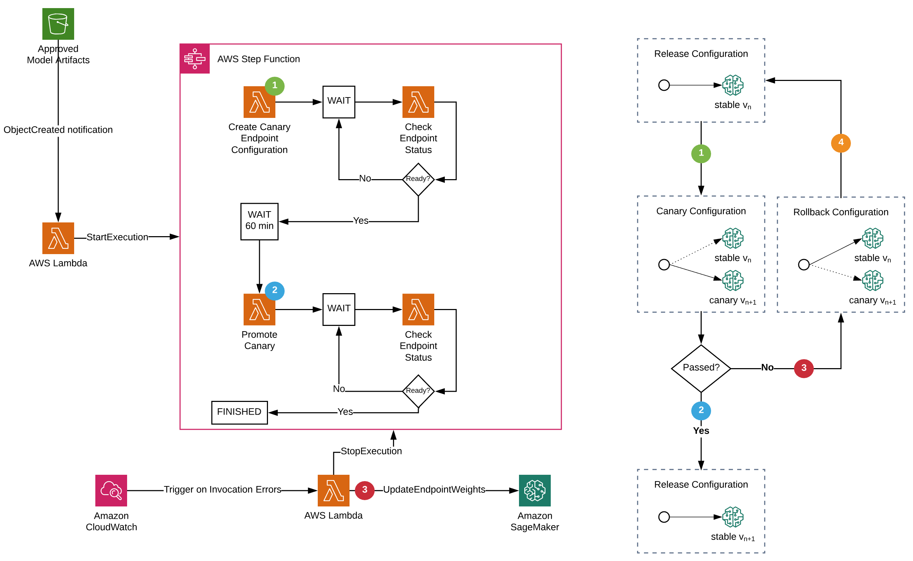
Notes:
Amazon was very interested in this, so they asked us to present at AWS re:Invent 2018

Slide 32


Jeff Keller
jeff@vtkellers.com
@jeff.keller
https://jeff.vtkellers.com

